Slide 1

Environment Monitoring
IOT PROJECT

Slide 2
environmental monitoring
Environmental monitoring is a tool to assess environmental conditions and trends, support policy development and its implementation, and develop information for reporting to national policymakers, international forums and the public.
Importance of Monitoring Environmental Parameters
The main objective of environmental monitoring is to manage and minimize the impact an organization's activities have on an environment, either to ensure compliance with laws and regulations or to mitigate risks of harmful effects on the natural environment and protect the health of human beings.

Slide 3

Relevance in Today’s Changing Climate
Climate change can also impact human health by worsening air and water quality, increasing the spread of certain diseases, and altering the frequency or intensity of extreme weather events

Slide 4
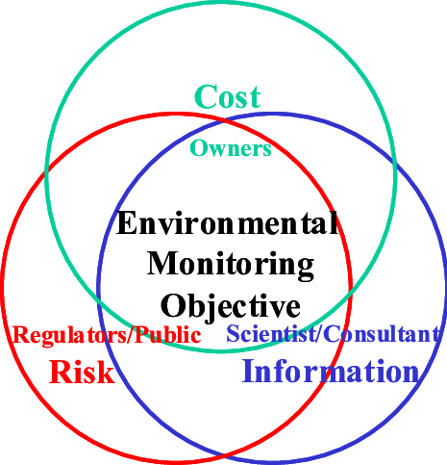
Objectives of Environmental Monitoring
Practical environmental monitoring applications include protection of public water supplies
management of hazardous and radioactive waste
identification and analyzation of pollution sources that affect urban air quality and its effects on human health

Slide 5
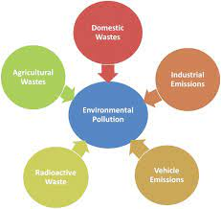
Types of Environmental Monitoring
Air Quality Monitoring
Water Quality Monitoring
Soil Health Monitoring
Biodiversity and Ecosystem Monitoring

Slide 6
Case Studies
Highlight specific examples of successful environmental monitoring projects:Clean Air Initiatives in Urban Areas
Water Quality Improvement Programs
Forest Conservation Projects

Slide 7
Benefits and Impact
Improved Public Health
Sustainable Development
Conservation of Ecosystems
Climate Change Mitigation

